Slide 1
BStack Demo Automation Testing
Using TestNG & BDD Framework with Page Object Model
Under the guidance of: Mrs. Vaishali Madam

Slide 2
Introduction
BStackDemo is a sample e-commerce website used for testing and automation practice
It simulates real-world user flows like login, search, cart, checkout, and more
This project involved automating end-to-end user scenarios using Selenium WebDriver, TestNG, and Cucumber (BDD)

Slide 3
Overview
Automated 12+ modules including login, favorites, cart, checkout, filters, search, and more
Used Page Object Model (POM) for maintainable and scalable code
Implemented both TestNG and BDD (Cucumber) frameworks for structured testing
Integrated with Maven and Jenkins for CI/CD pipeline

Slide 4
Module 1: SIGN-IN PAGE
Objective: Verified the functionality of BStacks sign-in system
Tests Performed:
- Validated username and password fields with demo credentials
- Checked successful login and session initiation
- Confirmed redirection to the homepage post-login

Slide 5
Module 2: FAVOURITES
Objective: Ensured users can add and remove items from favourites.
Tests Performed:
- Added an item to favorites and verified the addition
- Navigated to the favorites section to confirm visibility
- Removed the item and confirmed the update

Slide 6
Module 3: ADD TO CART
Objective: Validated the cart workflow for a seamless shopping experience
Tests Performed:
- Added a specific item to the cart
- Verified cart icon updated with the item count
- Closed the cart popup and continued shopping

Slide 7
Module 4: REMOVE FROM CART
Objective: Ensured users can easily modify their cart
Tests Performed:
- Opened the cart and removed the added item
- Verified cart updates and emptiness
- Closed the cart post-removal

Slide 8
Module 5: CHECKOUT PROCESS
Objective: Validated end-to-end checkout functionality
Tests Performed:
- Added item to cart and proceeded to checkout
- Filled in address details (name, address, province, postal code)
- Downloaded order PDF and continued shopping

Slide 9
Module 6: VENDORS FILTER
Objective: Tested vendor-based filtering
Tests Performed:
- Selected and deselected vendors (Samsung, Google, Apple, OnePlus)
- Verified that product listings updated according to vendor selection

Slide 10
Module 7: DROPDOWN FILTERS
Objective: Validated sorting and filtering via dropdown
Tests Performed:
- Used dropdown to filter by "Lowest Price" and other criteria
- Verified product order changed accordingly

Slide 11
Module 8: SEARCH FUNCTIONALITY
Objective: Ensured the search feature returns accurate results
Tests Performed:
- Tested with multiple search terms: "Apple", "Google", "Samsung", etc.
- Verified search results

Slide 12
Module 9: FOOTER LINKS
Objective: Tested footer navigation links
Tests Performed:
- Clicked the "Privacy Policy" link in the footer
- Verified the page loaded correctly and returned to homepage

Slide 13
Module 10: NEWSLETTER SUBSCRIPTION
Objective: Validated email subscription functionality
Tests Performed:
- Entered email into the newsletter subscription field
- Verified input acceptance

Slide 14
Module 11: HEADER LINKS
Objective: Tested header navigation links
Tests Performed:
- Navigated to "Offers", "Orders", and "Favorites" via header
- Verified correct redirection and page content

Slide 15
Module 12: LOGOUT
Objective: Ensure secure session termination
Tests Performed:
- Logged out via account menu
- Verified redirection to the homepage and session clearance

Slide 16
Defects
While running a testcase at certain point some fields are not working as it is expected which is nothing but a defect, so I have created a Defect report on those defects.

Slide 17
Defect Identifier:D_001
Defect Summary: Search Option is not working as per the requested search
Test Id:TC_001,TC_002
Test Case Name: bstack_search, bstack_invalidsearch
Module Name: Search Bar
Reproducible: When we search for "Samsung" then the search is not highlighting the requested search or not yielding proper search related to the requested search text
Severity: Medium
Priority: Medium
Raised By: K.Jayadeep
Assigned To: Developer
Date of Assignment:
Status: Pending
Fixed By: Developer
Date of Fixing:

Slide 18
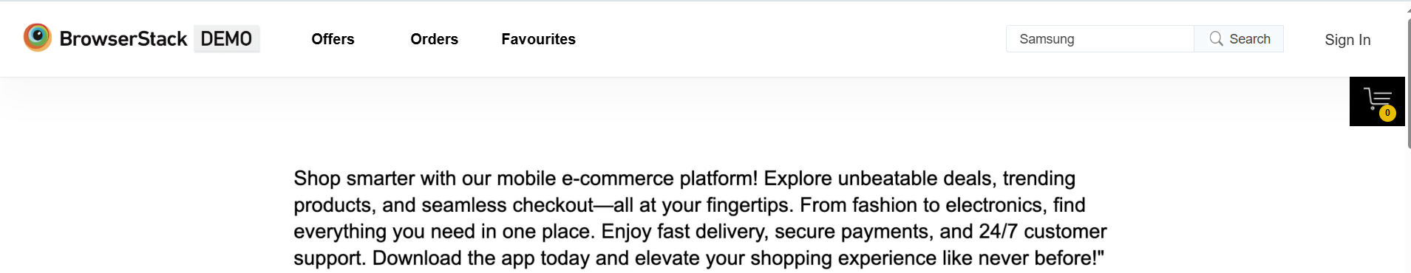
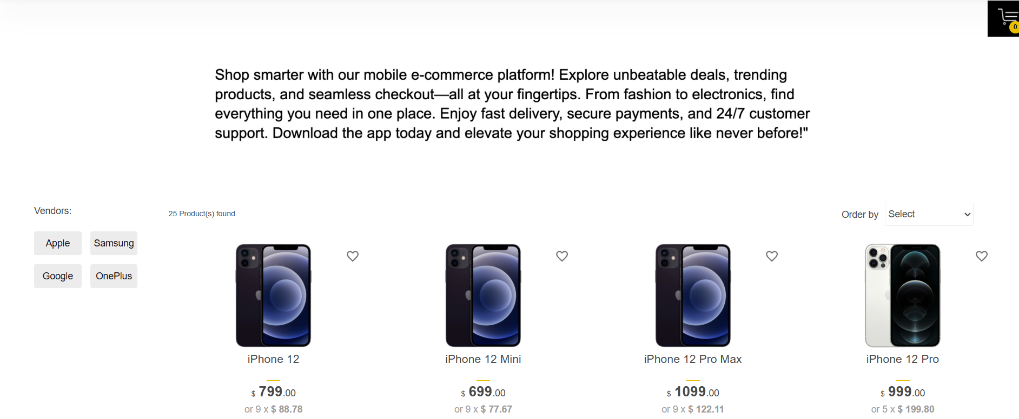

Slide 19
Defect Identifier:D_002
Defect Summary: Responsiveness across different devices
Test Id:TC_001
Test Case Name: bstack_responsiveness
Module Name: Responsiveness across different mobiles
Reproducible: When checking across at different devices the website layout is not aligned properly
Severity: Medium
Priority: Medium
Raised By: K.Jayadeep.
Assigned To: Developer
Date of Assignment:
Status: Pending
Fixed By: Developer
Date of Fixing:

Slide 20
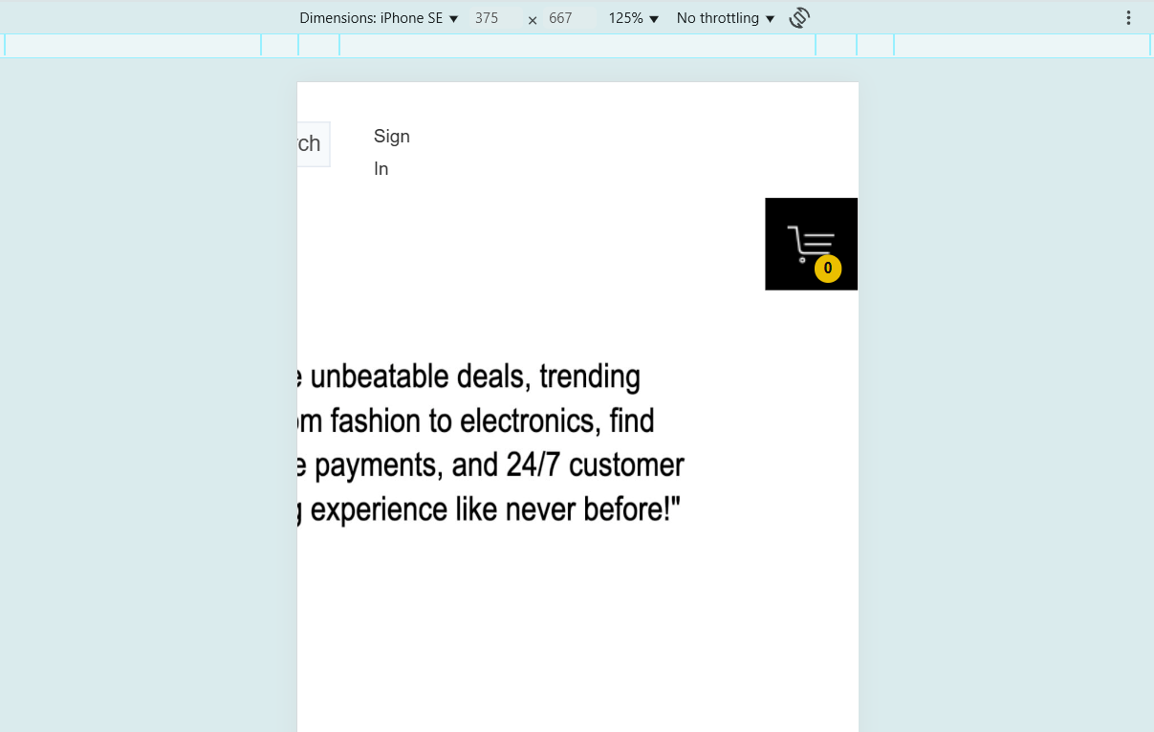

Slide 21
Defect Identifier:D_003
Defect Summary: Privacy policy read more is not redirecting to the privacy policies page
Test Id:TC_001
Test Case Name: bstack_privacy_policyreadmore.
Module Name: Footer Links
Reproducible: while clicking on readmore the page is refreshing but not navigating to the expected privacy policy page.
Severity: Medium
Priority: Medium
Raised By: K.Jayadeep.
Assigned To: Developer
Date of Assignment:
Status: Pending
Fixed By: Developer
Date of Fixing:

Slide 22
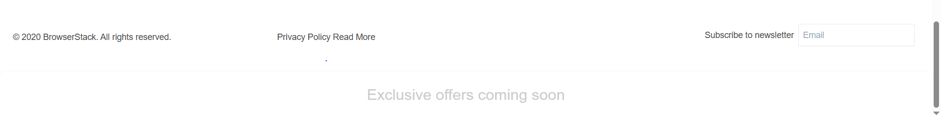
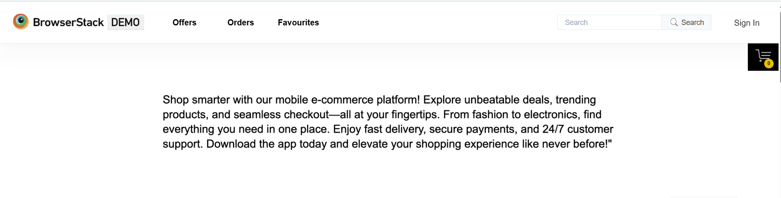
Redirecting to Homepage:

Slide 23
Defect Identifier:D_004
Defect Summary: Subscribe email is not working properly
Test Id:TC_002
Test Case Name: bstack_subscribe email valid email
Module Name: Subscribe email
Reproducible: When we enter any maild either valid or invalid we are not getting any mail to the valid mail id that you are subscribed to offers .
Severity: Medium
Priority: Medium
Raised By: K.Jayadeep.
Assigned To: Developer
Date of Assignment:
Status: Pending
Fixed By: Developer
Date of Fixing:

Slide 24
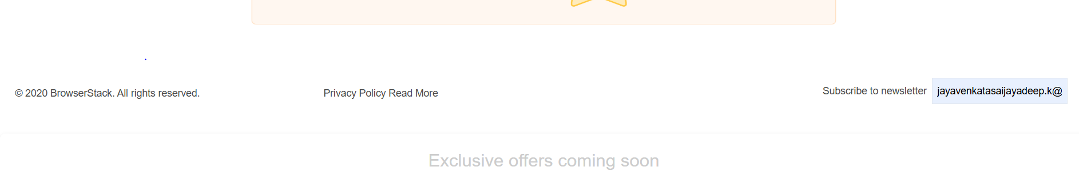
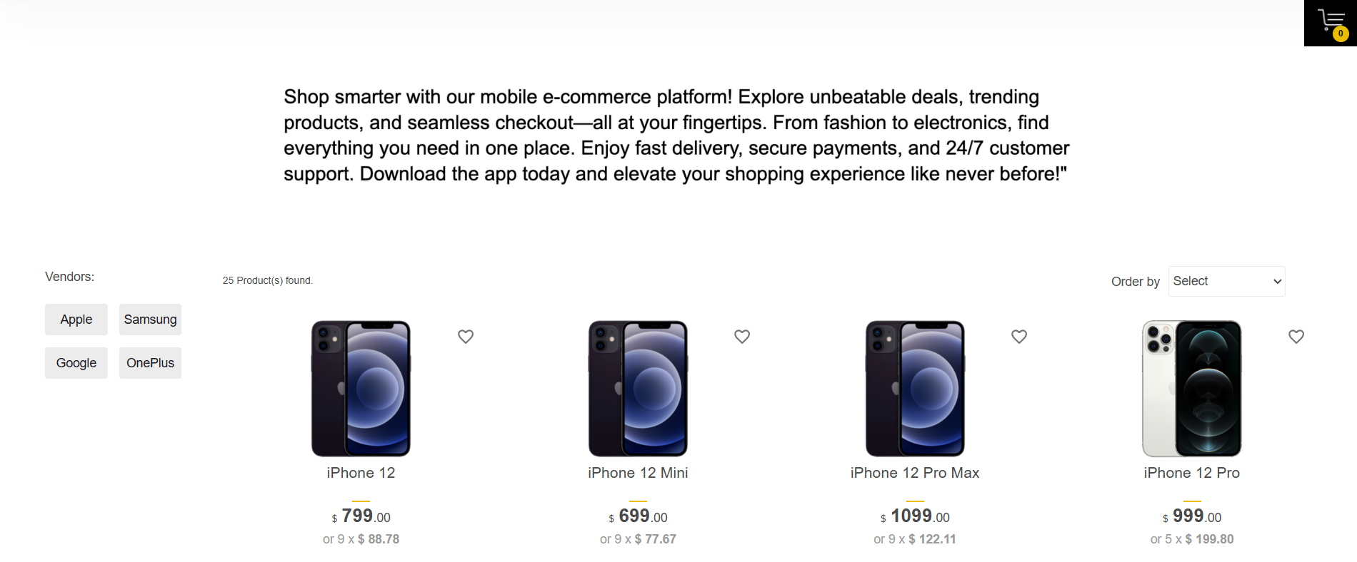
No message related to Subscription

Slide 25
Challenges
Handling dynamic elements and hover menus
Login module

Slide 26
Experience
Gained hands-on experience in Selenium WebDriver, TestNG, and Cucumber
Implemented Page Object Model for better code structure
Integrated tests with Maven and Jenkins for CI/CD
Developed skills in cross-browser testing and automation reporting
Learned to handle test failures and synchronization issues

Slide 27
Test Execution Results
All 16 test scenarios passed successfully
Total execution time: ~4 minutes (Maven) / ~2.5 minutes (Jenkins)
Reports generated in HTML, JSON, and JUnit formats
Jenkins pipeline executed successfully with zero failures

Slide 28
Thank You
Special thanks to Mrs. Vaishali Sonanis Madam for guidance and support

